Slide 1
Edu-Solutions West Towson Elementary
Paul Yun
Colby Wellens
Collin Woodruff

Slide 2
Introduction
Creating a very simple School-management system for West Towson Elementary.
Does not require complex course requirements(dependencies).
Affordable and easy to use.

Slide 3
History & Info Regarding W.T. Elementary and General
Facility opened in 2010
School capacity holds 451 students
32 classroom teachers
Average class size 21.9 – 24.9
-----------------------------------------------------------------------------------------------
Total taxpayer investment in K-12 education in U.S. for 2004-2005 is estimated to be around $536 billion.

Slide 4
Requirements for Users
Admins | Create/Delete accounts for students, teachers, and staff Access all data
Teachers | Access students’ information based on class Edit student’s grades
Staff | View relevant employee data
Students | View their grades

Slide 5
Activity Scenarios
Admin logs in and enters new employee or teacher information into system.
Admin logs in and deletes old employee information due to termination.
Teacher logs in and views students’ grades and attendance.
Teacher logs in and edits students’ grades and attendance.
Staff logs in and views personal information and limited information on other employees.
Students log in and view grades and attendance.

Slide 6
Advantages
Simple interface allows for easier creation, deletion, and maintenance of accounts and user information.
Teachers and students can view grades and attendance easily.
Staff can view their information easily and request to update information.

Slide 7
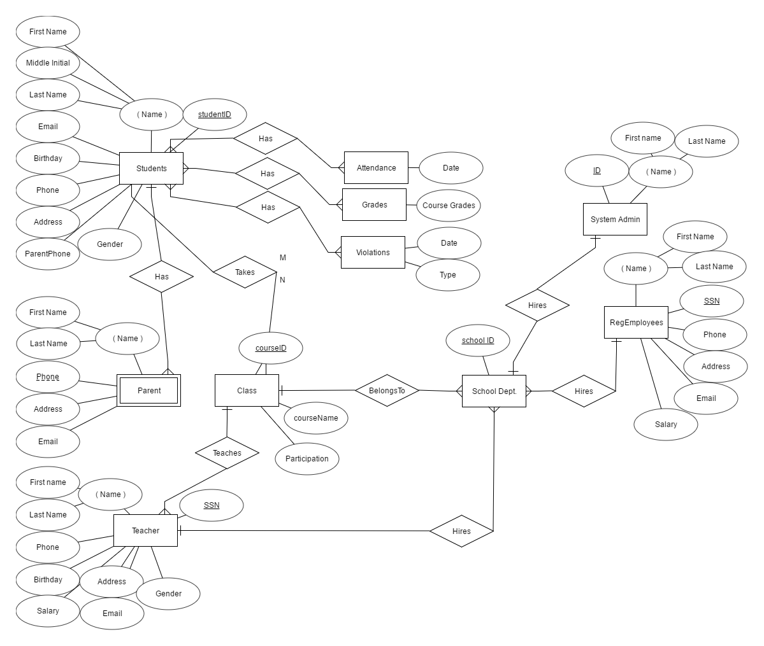
ERD

Slide 8
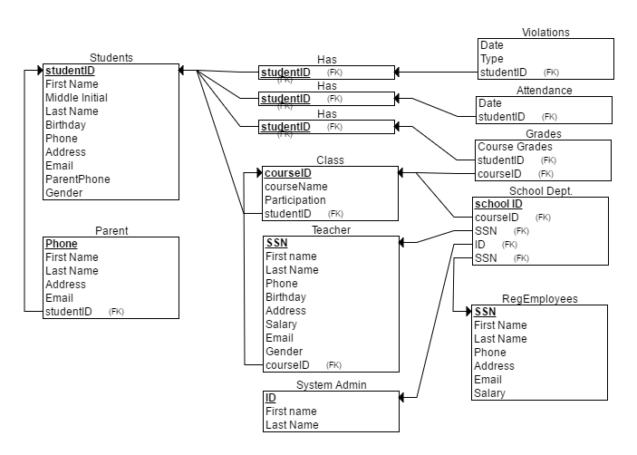
ERD SCHEMA

Slide 9
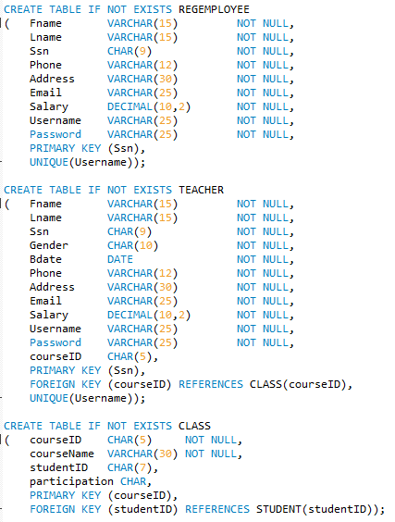
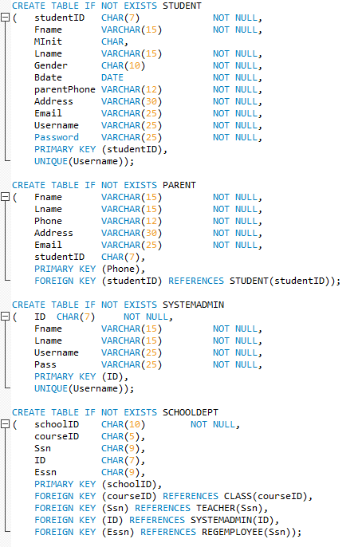
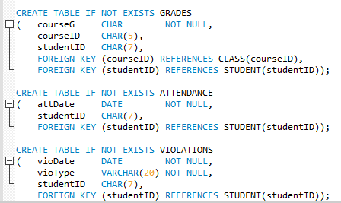
CREATE STATEMENTS

Slide 10
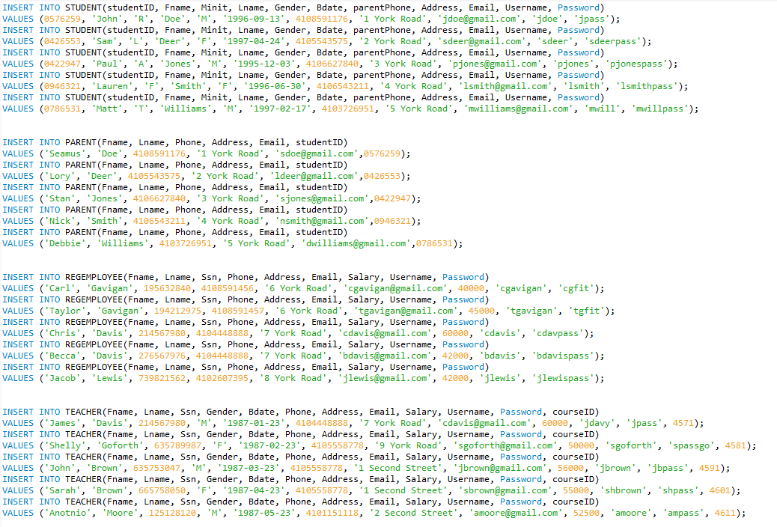
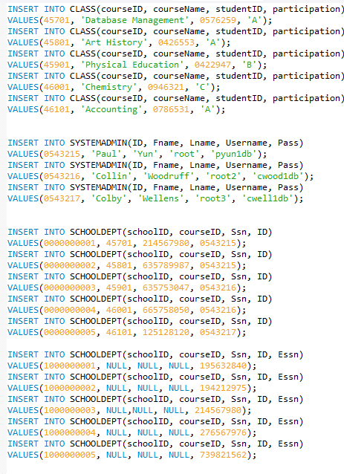
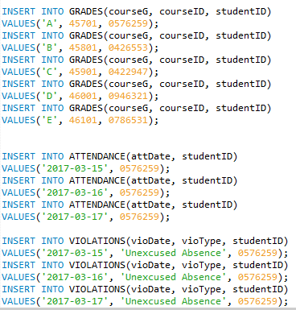
INSERT STATEMENTS

Slide 11
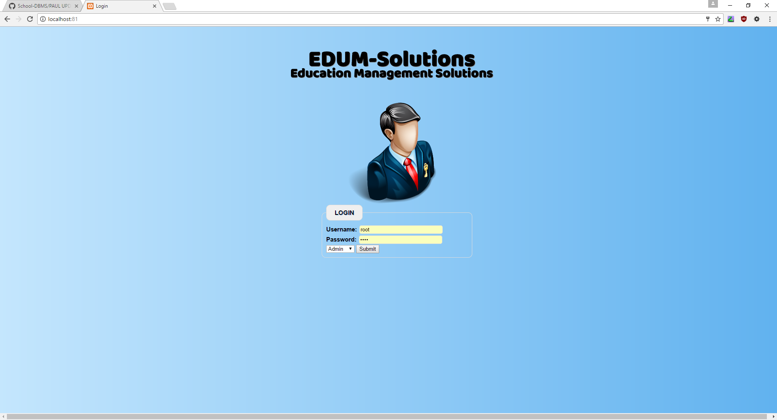
Login Interface

Slide 12
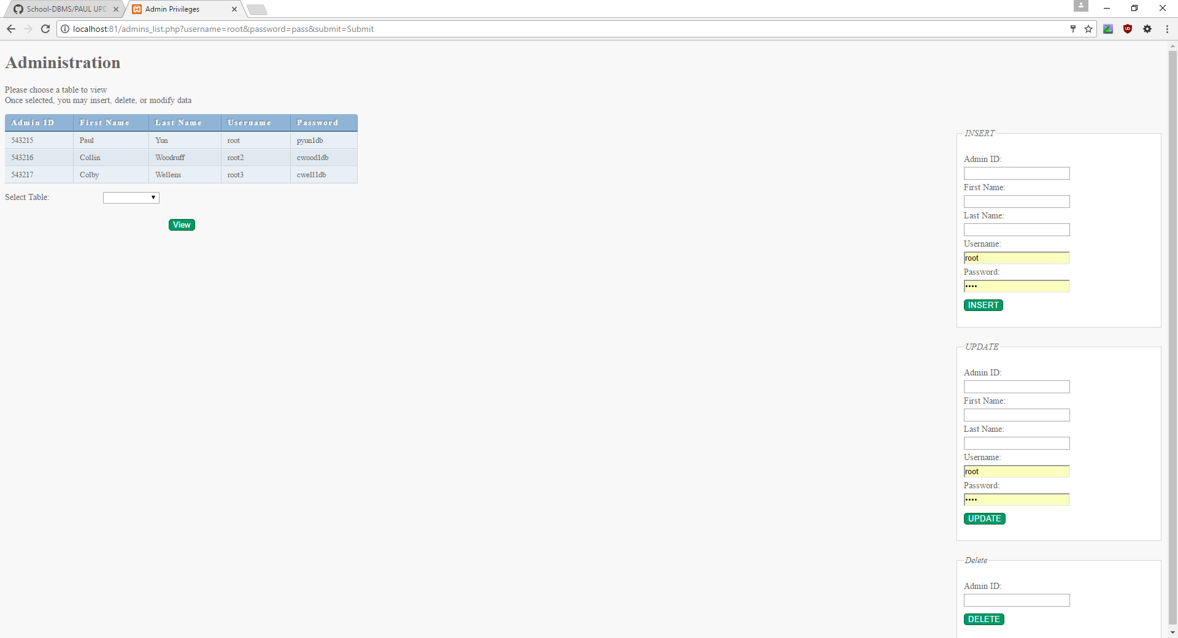
Admin Page

Slide 13
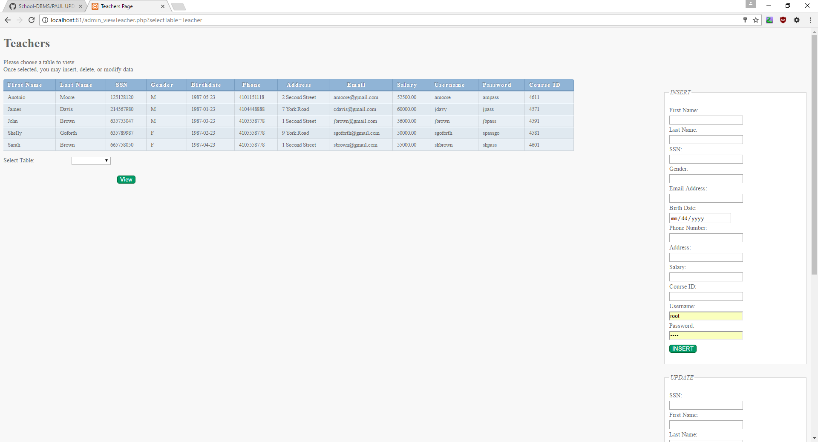
Viewing Teachers

Slide 14
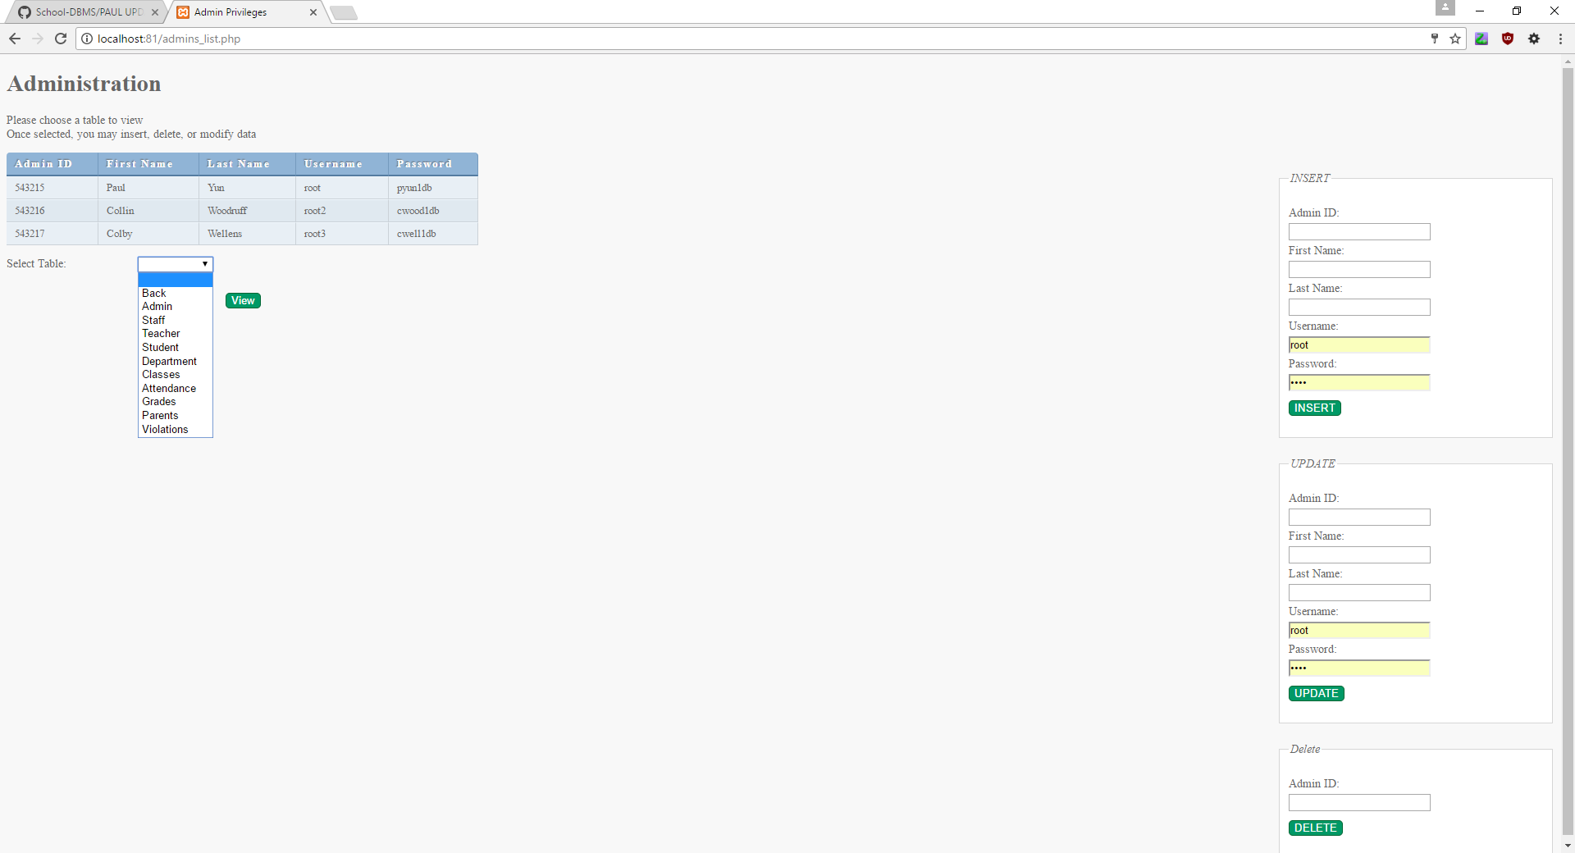
Full List of Admin Page Access

Slide 15
Conclusion
FULL WEBSITE FEATURES CAN BE FOUND IN TUTORIAL_DEMO.PPTX
REFERENCE MANUAL WILL DEMO THE ADMIN’S ABILITY TO INSERT, UPDATE, AND DELETE DATA FROM THE SITE ITSELF

